Slide 1
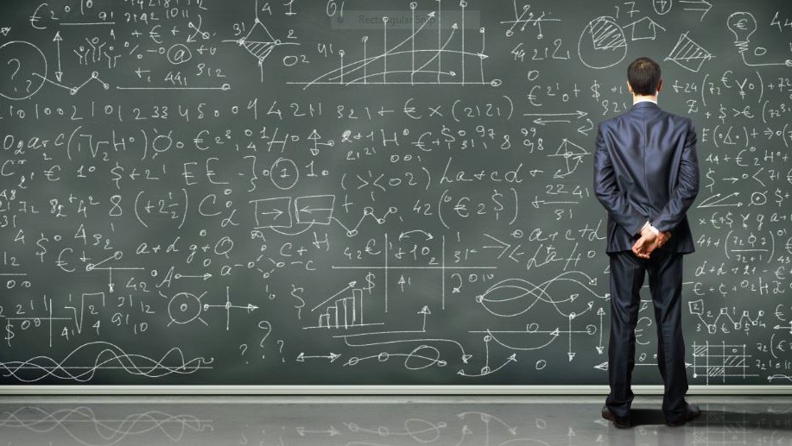

Dates & Times
Programming
Data Science, Business Analytics & AI
Erasmus Quantitative Intelligence

Slide 2

Working with Dates and Times in pandas
Many datasets contain dates or times (or both)
Use pd.to_datetime() to convert text into datetime objects
Datetime columns in pandas usually have type datetime64[ns]
You can do calculations with datetimes, for example:
Subtract two dates to get a time difference
Add days, hours, or weeks with pd.Timedelta or DateOffset
import pandas as pd
from datetime import datetime

Slide 3
Date-times as a Data Type in pandas
Datetimes in pandas are stored as datetime64[ns] (nanosecond precision)
This is stored internally as ns, but shown as dates/durations for readability
Values represent points in time relative to the Unix epoch (1970-01-01), with time zone support if specified
A single datetime is represented by a pd.Timestamp object
Durations between datetimes are represented with pd.Timedelta
Use pd.to_datetime() to parse text values into datetime objects
Notes:
Tom Scott on timezones: https://www.youtube.com/watch?v=-5wpm-gesOY

Slide 4
Time Periods in pandas
Timedelta
Represents a duration based on clock time (e.g., pd.Timedelta(hours=1))
Can be added to or subtracted from datetimes
Not tied to a specific start or end time
Interval
Represents a time range with a defined start and end
Created with pd.Interval()
Useful for binning/grouping data into periods

Slide 5
Date and Time Formats in pandas
pd.to_datetime() can automatically parse many common formats
parsing fails, you can specify a format string
Common format codes (Look this up when you need it)
%Y → 4-digit year (2023)
%y → 2-digit year (23)
%m → month number (01–12)
%d → day of month (01–31)
%H → hour (24-hour clock, 00–23)
%M → minutes (00–59)
%S → seconds (00–59)

Slide 6
Exercise 1

Slide 7
Error handling
Whether you are an experienced programmer or not: everyone encounters errors regularly
Recognizing and fixing errors is an essential programming skill:
Partly a matter of experience
With a few tips, you can already get a long way

Slide 8
ERROR FIXING
To solve an error, you need to know:
Where the error occurs
What causes the error
How to fix the error
But how do you find out?

Slide 9
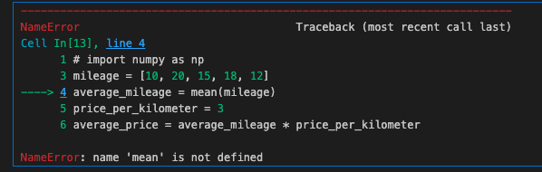
READ THE ERROR CAREFULLY
The error message often tells you:
Where the error occurs & What kind of error it is
mileage = [10, 20, 15, 18, 12]
average_mileage = mean(mileage)
price_per_kilometer = 3
average_price = average_mileage * price_per_kilometer print("The average price is:", average_price)

Slide 10
ERROR TYPES
Common Python Errors
SyntaxError: Incorrect syntax, often a missing or misplaced character
NameError: Variable or function does not exist, often a typo or missing import
TypeError: Wrong type of object used in an operation
ValueError: Correct type, but the content/value is invalid
FileNotFoundError: File not found at the given location
IndexError / KeyError: The index or key you are trying to access does not exist

Slide 11
TRACEBACKS
Many functions call a series of other functions “under the hood.”
If an error occurs in one of these underlying functions, the traceback shows which part of the code caused it.
Tracebacks can be long and intimidating, but the most important information is usually at the top and bottom.
countries = ["Netherlands", "Belgium", "Germany", "France"]
population_mln = [17.9, 11.8, 83.5, 68.5, 9.5]
import matplotlib.pyplot as plt plt.bar(countries, population _mln)

Slide 12
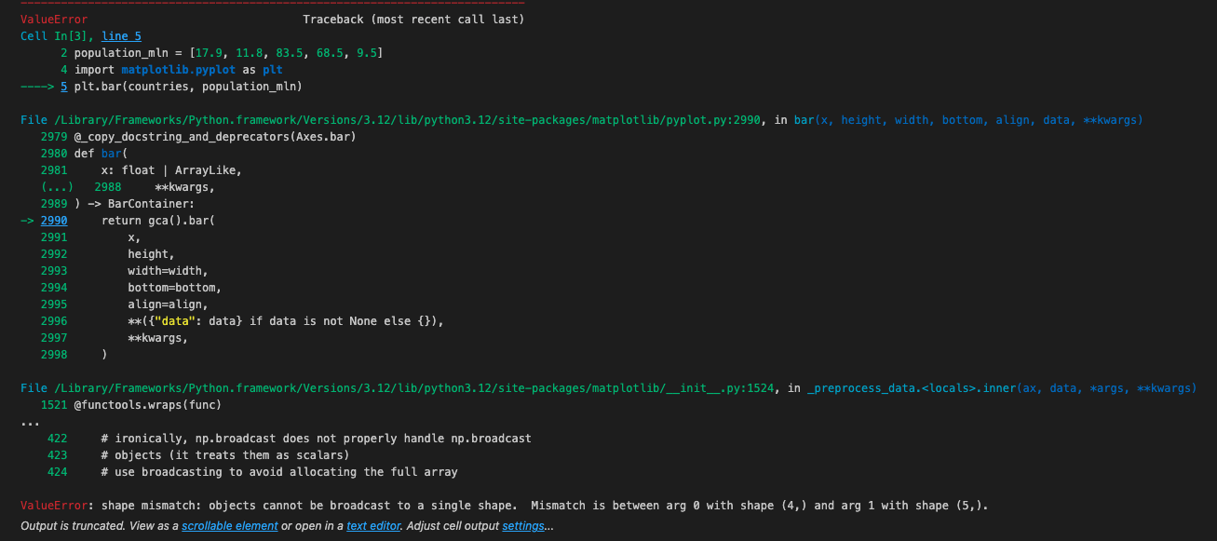
TRACEBACKS
Our code
Underlying matplotlib-function
The error description

Slide 13
SPLIT YOUR CODE
If the traceback doesn’t make it clear where the error occurs, split your script or cell into smaller pieces.
By running the code line by line, it will become clear which line causes the error.

Slide 14
WHAT IF YOU DON'T UNDERSTAND AN ERROR?
Error messages can sometimes be hard to understand. There are always others who have faced the same problem. Check online resources:
ChatGPT / Claude / Copilot – Be careful not to share sensitive data
Google / StackOverflow / other forums – Often provide useful solutions

Slide 15
Exercise 2

